Slide 1
Review III Peltier Refrigerator
PROJECT GROUP-54
1.Chougule Nishant Dilip
2.Shelke Dhananjay Vilas
3.Shelke Mayur Eknath
4.Kokane Tejas Vikas
UNDER THE GUIDANCE OF
Prof. R. R. Yenare

Slide 2
Content
Introduction
Literature review
Problem definition
Objectives
Scope
Methodology
Design
Manufacturing
Advantages
Disadvantages
Applications
Conclusion

Slide 3
Introduction
There are many products currently in the market that have the ability to preserve ice, including mini and electric portable refrigerators and freezers. But these options are either not truly portable or cannot consistently maintain the desired temperature. Coolers use ice that melts. Portable refrigerators and freezers are limited to an AC/DC power source that is bulky and difficult to move from place to place, thereby limiting where it's transportability.
The Peltier Refrigerator is our solution to an array of problems relating to the lack of portable refrigeration. The applications of how and where this product can be used are endless.
The Peltier Refrigerator is a portable, self-sustaining, solar-powered, collapsible refrigerator and freezer that can go anywhere.
You can charge the Peltier Refrigerator before you go out and if the sun goes down or you run out of sunlight, the battery will kick in and continue cooling your food/beverages/dead body until the sun is back, and better yet you can leave it outside all year long as it is weather proof.

Slide 4
Literature review
Awasti, M., & Mali, K. (2012). Design and Development of Thermoelectric Refrigerator. International Journal of Mechanical Engineering and Robotics Research(Volume No. 3). The retention time achieved was 52 min with the designed module in this project. To achieve a higher retention time, another alternative was incorporated. This consists of the additional heater on a heat sink.
Chetan Jangonda, K. P. (2016). Review of various Applications of Thermoelectric Module. Thermoelectric cooling added a new dimension to cooling. It has a major impact on a conventional cooling system. It is compact in size, no frictional elements are present, no coolant is required and the weight of the system is low.
D. Suman, p. H. (2020). Design and fabrication of thermoelectric refrigerator using peltier module. The efficiency and life of the Peltier refrigerator are maximized by using these water pockets and the temperature was controllable by changing the input voltage and current so we can maintain the things at the required temperature. Finally, it has been recorded the minimum temperature i.e., 2°c.

Slide 5
Literature review
Jatin Patel, M. P. (2016). Improvement in the COP of Thermoelectric Cooler. This study experimentally investigates the performance of the single-stage and multistage TEC air-cooling module. It is quite easy to achieve a significant temperature difference in the single-stage TE module, but, the COP of the single-stage module is very less for domestic use. In the multistage TE module, It is possible to get the required COP as well as better thermal performance.
Kshitij Rokde.Mitali Patle, T. k. (2017). Peltier Based Eco-Friendly Smart Refrigerator for Rural Areas. The efficiency of the refrigerator can be increased by increasing the number of Peltier plate modules which will eventually help in decreasing the temperature in less time. The number of Peltier plate modules used can be calculated using the heat transfer formula.
V.rajangam, m. (2015). Design and cfd analysis of thermoelectric cooling system. The design parameters involved a thermoelectric cooling system. Experimental work is carried out to obtain a temperature up to 5 degrees Celsius. An attempt was made in validating the experimental work with the CFD analysis by giving sufficient boundary conditions. Further, this work could be enhanced with different thermoelectric materials to attain high performance.

Slide 6
Problem Definition
The Peltier Refrigerator liberates the convenience of industrial refrigeration from the limitations of your home. It runs off of detachable solar panels which simultaneously charge the builtin lithium-ion battery. On one complete charge, the Peltier Refrigerator can last a full night.
We want to have access to a fully functional refrigerator wherever and whenever, whether you're camping, tailgating, caught in a natural disaster or without power for days. The Peltier Refrigerator is equipped to perform like an industrial-strength refrigerator while being portable and accommodating, making it perfect for the outdoorsman, the frugal minded and the utilitarian.

Slide 7
Objectives
There are so many refrigerators available in market but they have their own limitations due to which they are they are not beneficial for special purposes.
Our main objective in this project is to develop a low-cost portable solar powered refrigerator for special and small needs.
The design should be simple and the size must be compact to carry.
It should be light weight in nature and does not require any external power source for operation other than solar.

Slide 8
Scope
There are some points that could be researched in future:
Using two TECs in different configurations.
Developing a power sharing PV regulator.
Using Two TECs Totalling the Designed Qc-
Smaller TECs could be connected in parallel with a combined Qc value equal to the design Qc value. The whole idea being that a two step cooler box could be developed that can operate at half power or at full power, depending on one or both TECs being powered. This would simplify the design of a power sharing regulator since the power to the cooler box does not need to be regulated in conditions where it is required to operate at half of the maximum input power.
Developing a Suitable Power Sharing Regulator-
A power sharing regulator should be developed for the cooler box. This regulator should be able to regulate the amount of power received from the PV panel and distribute it to battery and the cooler box in such a manner that the system works at peak efficiency. This means the battery being fully charged, the excess power would be channelled to the cooler box. At night, the regulator should provide the cooler box with just enough current to maintain the inside temperature until the next day.
Further research should be done on the different possibilities to see if a better COP could be achieved. This is important since the power from a PV panel is limited due to cost. A power sharing regulator should be developed and the performance should be tested (depending on the TEC configuration that is used), and the whole system should be tested in real life conditions to see how effective it operates.

Slide 9
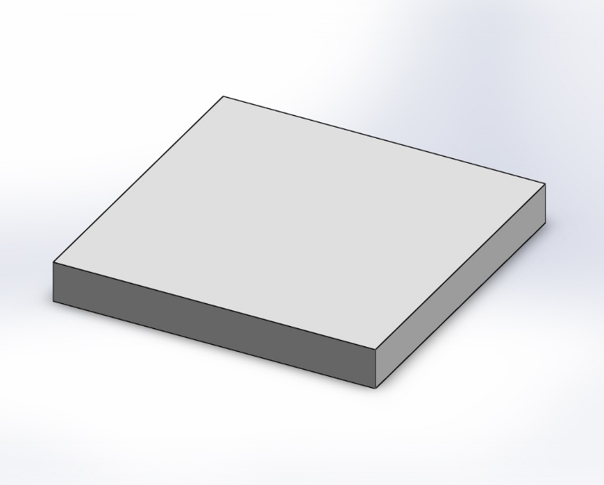
Design
Peltier Module

Slide 10
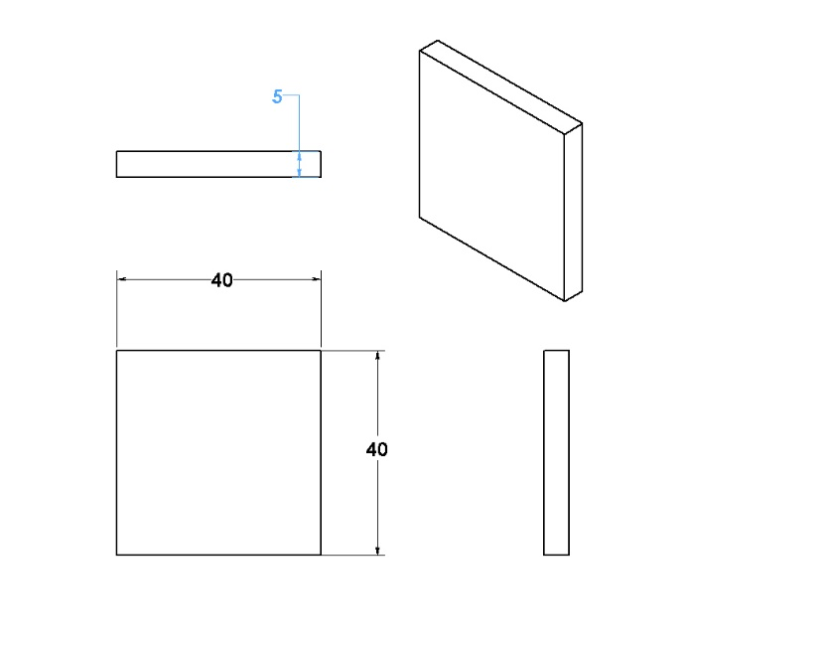
Design
Drafting of Peltier module

Slide 11
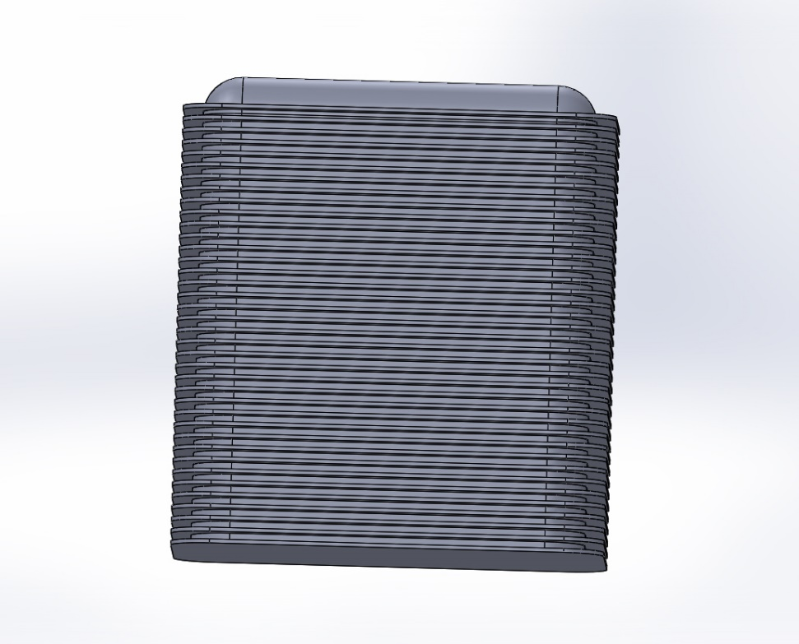
Design
Heat Sink

Slide 12
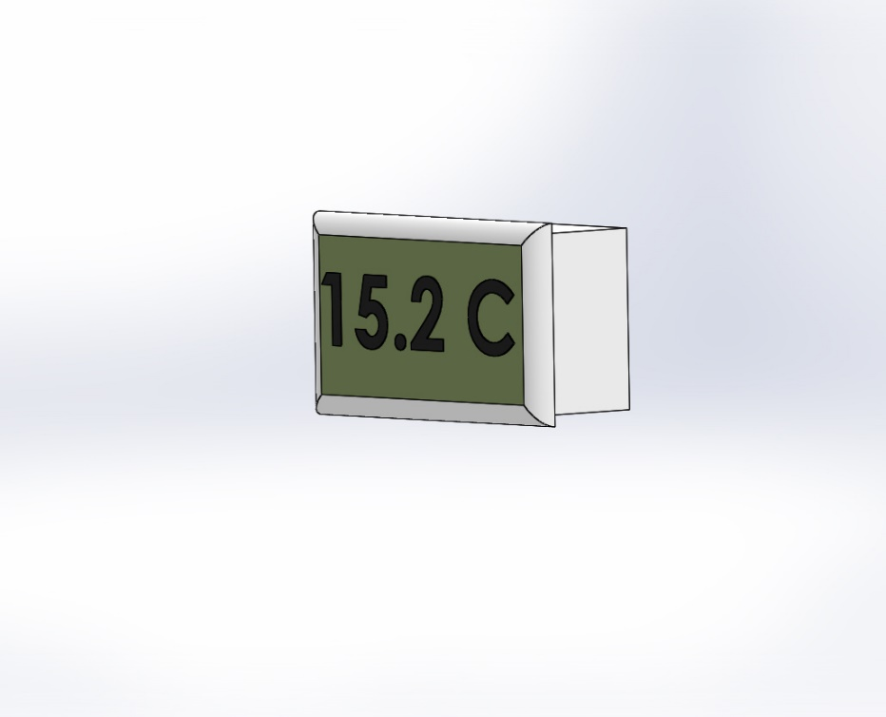
Design
Temperature Sensor

Slide 13
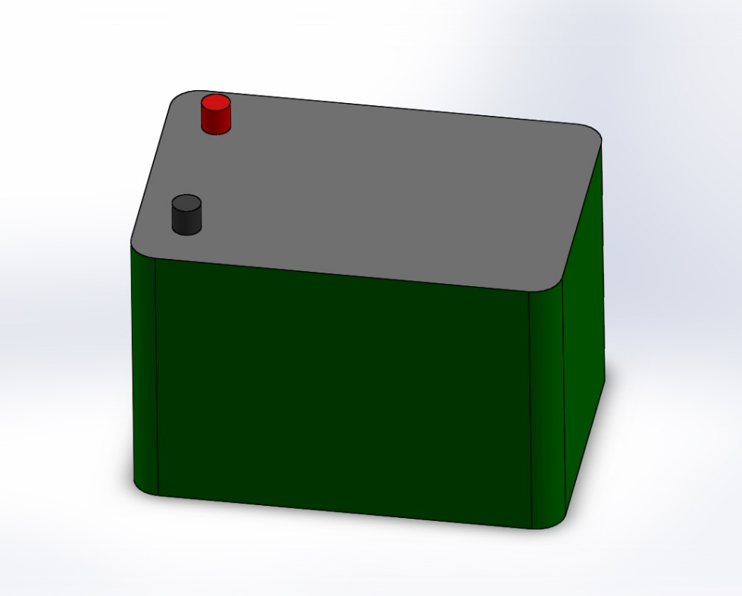
Design
Battery

Slide 14
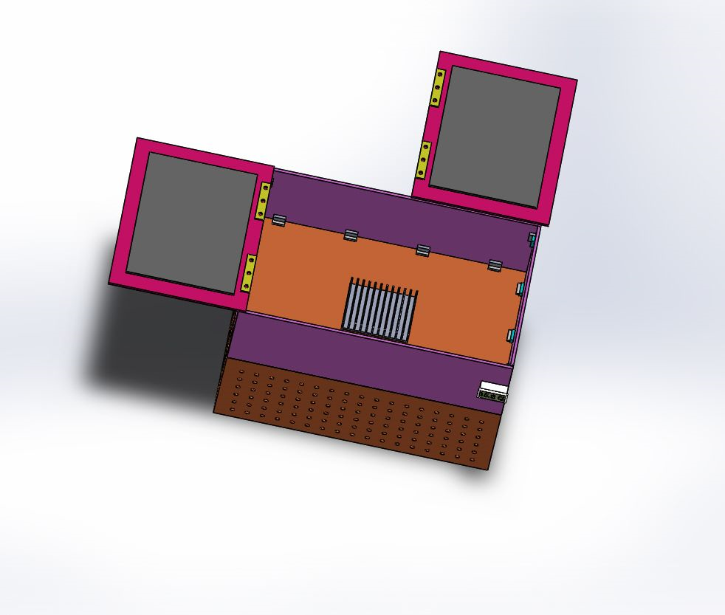
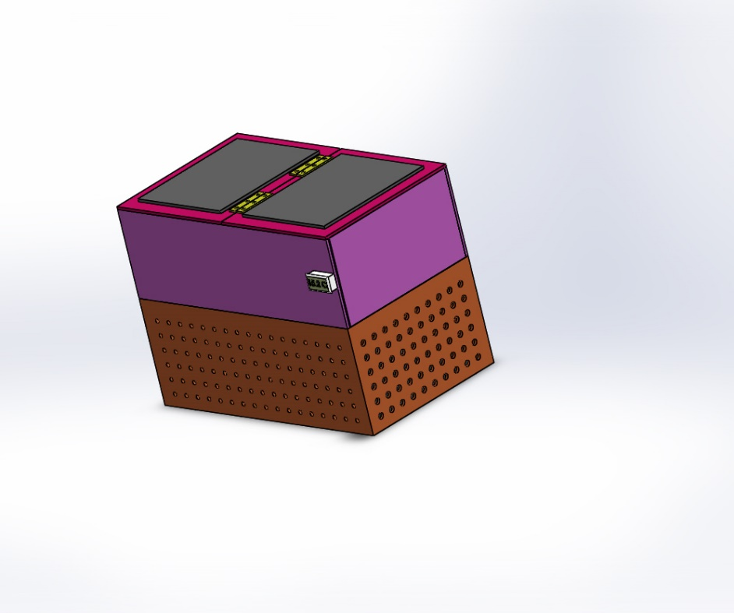
Design
Isometric view
Top view

Slide 15
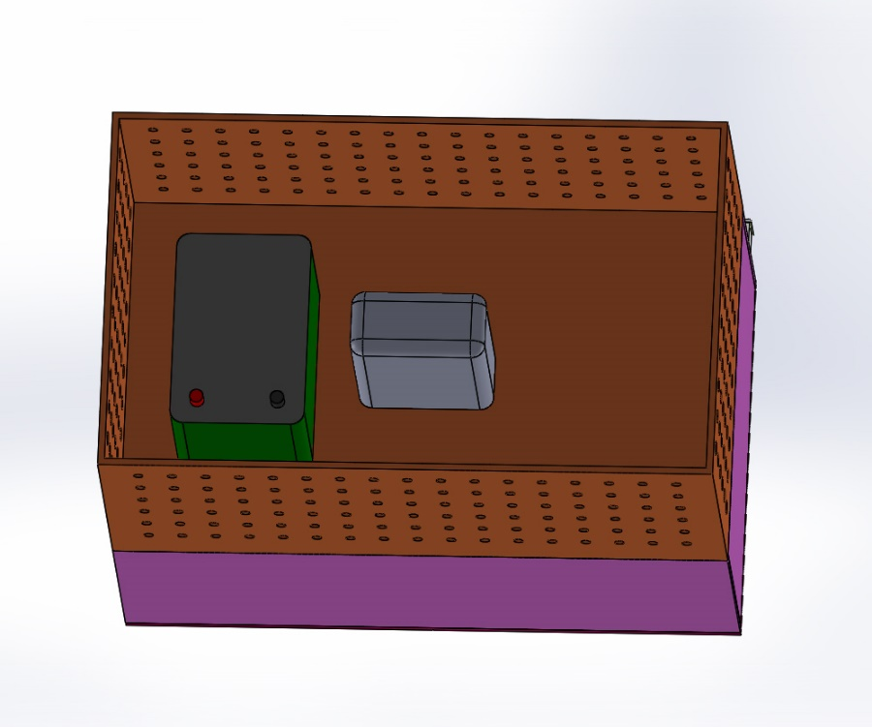
Design
Assembly

Slide 16
Advantages
Light weight and compact for very small heat loads.
No CFC gases or refrigerant are used for cooling.
No moving parts, eliminating vibration, noise, and problems of wear.
Very low-cost device for cooling in small appliances.
Solar operation makes it more economical and environment friendly

Slide 17
Disadvantages
Limited to very small refrigeration loads due to size compaction.
Not suitable for higher refrigeration use due to poor efficiency.
Thermo-electric modules become very heavy and bulky as the refrigeration capacity increases.
The technology is normally used only to cool small surfaces (for example a processor in a computer) since there have been complications when making the system bigger.

Slide 18
Applications
Medicine — Cooling containers for storage and transportation of tissue, blood, liquids, etc.
Fruits and flower storage.
Consumer Goods — portable picnic boxes, drinking water and beverage coolers, cooling boxes and cabinets for stores and cafes, massage equipment.

Slide 19
Conclusion
The main objective of the project is to achieve the long-term cooling in case of power failure for refrigerator. The present design can be used for maintaining a particular temperature. This is completely eco-friendly project multipurpose and portable. The coefficient of performance of this refrigerator is much smaller than that of a conventional compressor type refrigerator when the required cooling capacity is high. There are several different types of cooling devices available to remove the heat from industrial enclosures, but as the technology advances, thermoelectric cooling is emerging as a truly viable method that can be advantageous in the handling of certain small-to-medium applications.

Slide 20
References
[1] Angamuthu. K, A. D. (2020). Design and Manufacturing of Thermoelectric Mini Portable Refrigerator using Autodesk Fusion 360 with Additive Manufacturing. IJRTE, 7.
[2] Awasti, M., & Mali, K. (2012). Design and Development of Thermoelectric Refrigerator. International Journal of Mechanical Engineering and Robotics Research(Volume No. 3), 11.
[3] Chetan Jangonda, K. P. (2016). Review of various Applications of Thermoelectric Module. IJIRSET, 8.
[4] D. SUMAN, P. H. (2020). DESIGN AND FABRICATION OF THERMOELECTRIC REFRIGERATOR USING PELTIER MODULE. JETIR, 7(3), 5.
[5] Elavarasan E, S. S. (2018). Design and Fabrication of Mini Refrigerator with Thermoelectric Cooling. IJERT, 4.
[6] Gagan Bansal, Y. j. (2021). Solar Based polio-drop box system with Peltier effect technology: A review. ELsevier, 6.
[7] Jatin Patel, M. P. (2016). Improvement in the COP of Thermoelectric Cooler. IJSTR, 4.

Slide 21
Thank you

